Slide 1
A Flutter Based Chat App
A Flutter based android app

Slide 2
Introduction
The project is based on flutter and the dart programming language. It is an android application which allows and helps users to communicate with each other in their daily life. This is app is targeted to the college students and and young generations who are more likely engage in chatting with each other.
This app includes various features like chatting, search by name, profile view and edit ,etc..
This app is user friendly and includes just a single screen which has properly visible icons which guide user to perform the operations required to be seen.

Slide 3
Objective & Motivation
The objective is to design and develop an android app which helps people to communicate with each other.
The motivation behind this app is to connect different people with each other in the mode of chatting. We live in a world where many people are fighting with anxiety and depression. In this country people require a companion who can talk to them. With this app they will be able to communicate with other people and can reduce their depression. It also serves purpose for the students. With the help of a chat app students can connect to their teachers and ask their doubts. In this time of pandemic patient can not go to the doctors but with the help of chat app he/she can ask for the consultation from the doctor. This Chat application will help in bringing the positive change in the lives of the people and enhance their lifestyles.

Slide 4
Technologies Used
Flutter
Flutter is an open-source UI software development kit created by Google. It is used to develop applications for Android, iOS, Linux, Mac, Windows, Google Fuchsia, and the web from a single codebase.
Flutter offers outstanding performance for two reasons. First, is uses Dart, which compiles into native code. Second, Flutter has its own widgets, so there’s no need to access OEM ones
Dart Programming Language
Dart is a client-optimized programming language for apps on multiple platforms. It is developed by Google and is used to build mobile, desktop, server, and web applications.
Dart is an object-oriented, class-based, garbage-collected language with C-style syntax. Dart can compile to either native code or JavaScript.

Slide 5
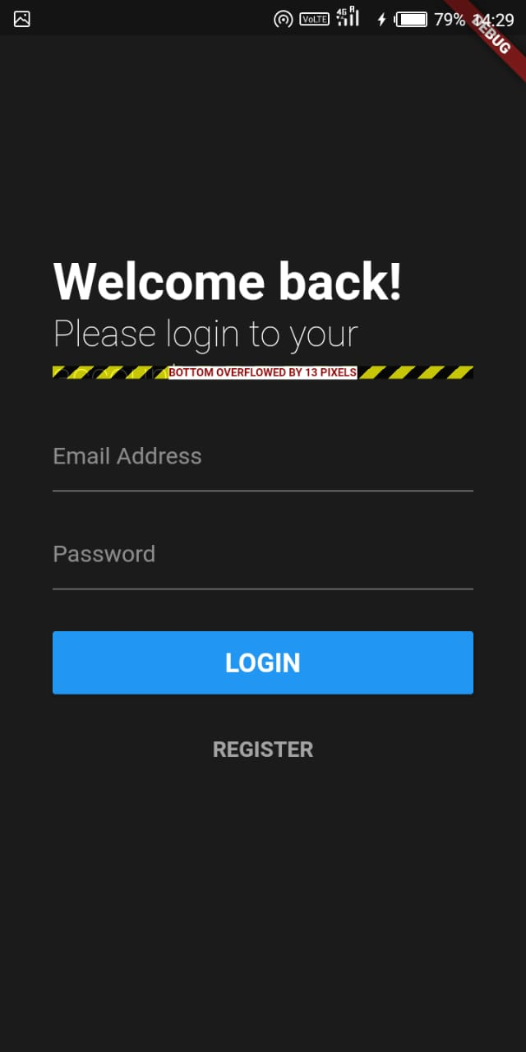
User Interface
The User Interface (UI) consists of 4 main things
Header
List Of Friends with Chat
Login & Sign Up
Profile Edit & View
Login page

Slide 6
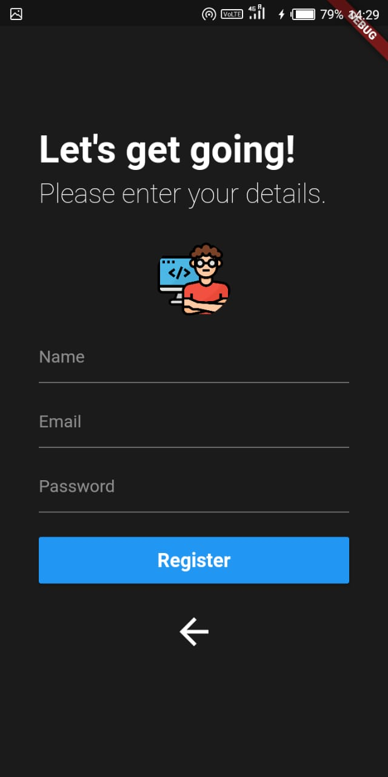
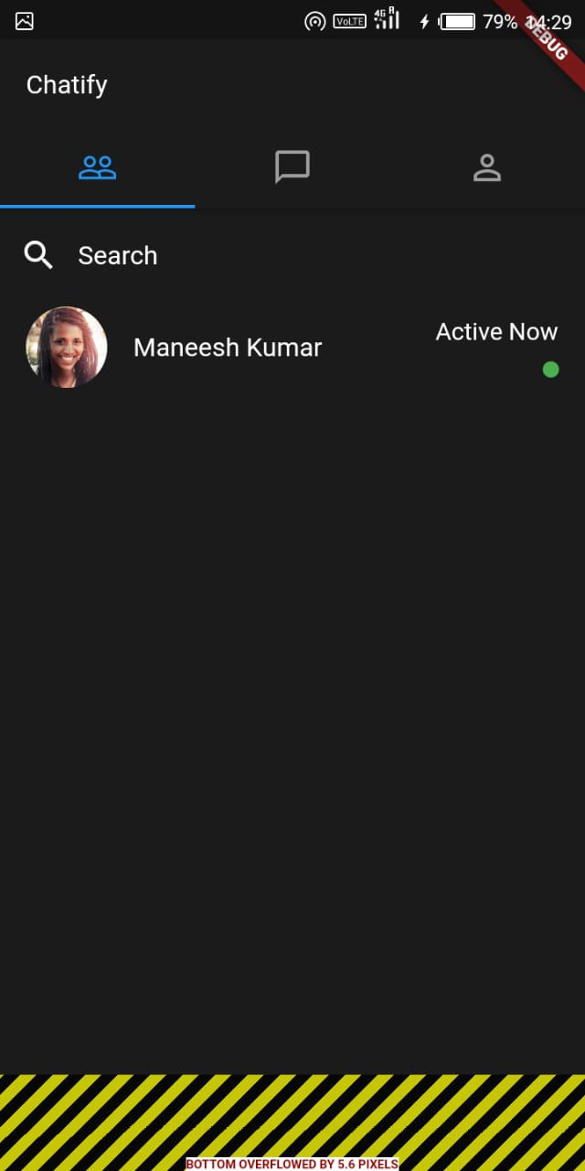
User Interface (cont.)
Register page
Contact page

Slide 7
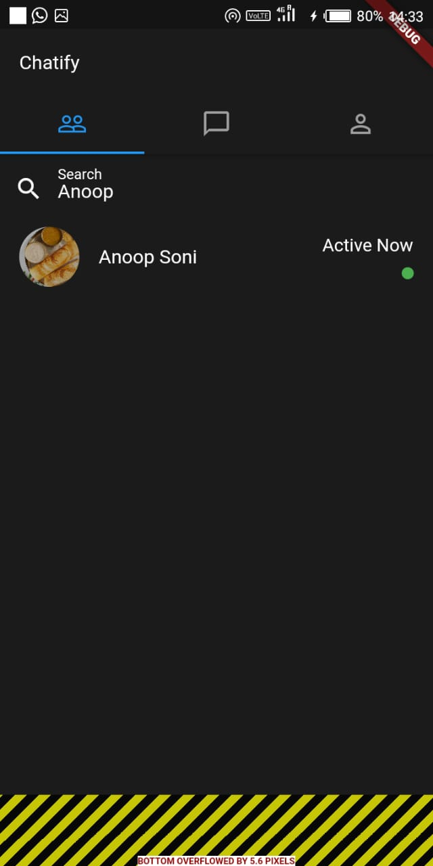
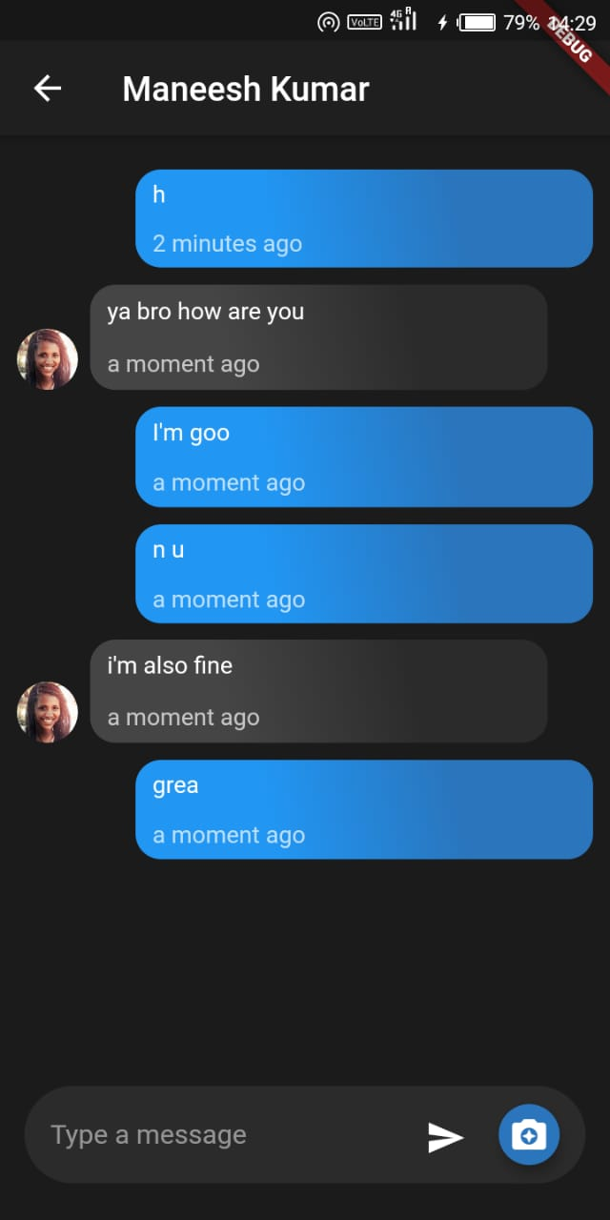
User Interface (cont.)
Other user contact page
Conversation page

Slide 8
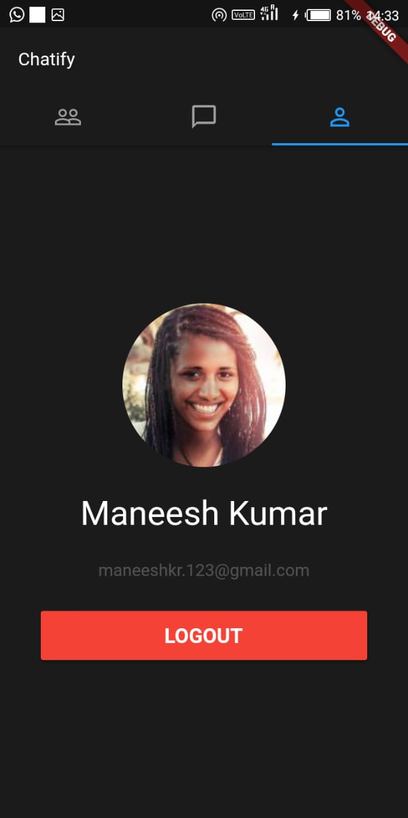
User Interface (cont.)
Logout page

Slide 9
Thank You

